Slide 1
Problem Statement :
Dynamic Route Optimization & Emission Reduction
Entry for
FedEx Smart India Hackathon, IIT Madras
Team name :- Likelihood Function
Github Repository :- https://github.com/HarshTantak/Dynamic-Route-Optimization-and-Emission-Reduction---FedEX-Hackathon

Slide 2
Team Name :- Likelihood function
Sanya Saxena
Msc Statistics and Data Science, Nmims Mumbai
Linkedin url
Harsh Tantak
Msc Statistics and Data Science, Nmims Mumbai
Linkedin url
Lawrence Mondal
Msc Statistics and Data Science, Nmims Mumbai
Linkedin url

Slide 3
Introduction:
Our solution is a Python-based dynamic routing system designed to optimize travel efficiency while reducing environmental impact. It integrates real-time data from multiple APIs, including traffic (TomTom), weather, air quality (AQICN), and route data (Google Maps, OSRM). Users provide their vehicle type, fuel type, and desired start and end points through a clean and interactive UI.
The backend processes this data, using a KNN model to predict refined travel times for each route by considering traffic density, weather conditions, and other factors. The A* algorithm is then applied to identify the optimal route based on time and distance, while an azure-deployed carbon emissions model estimates emissions for each route. The system displays the best route along with real-time metrics like ETA, distance, and emissions, enhancing decision-making for efficient and sustainable travel.

Slide 4
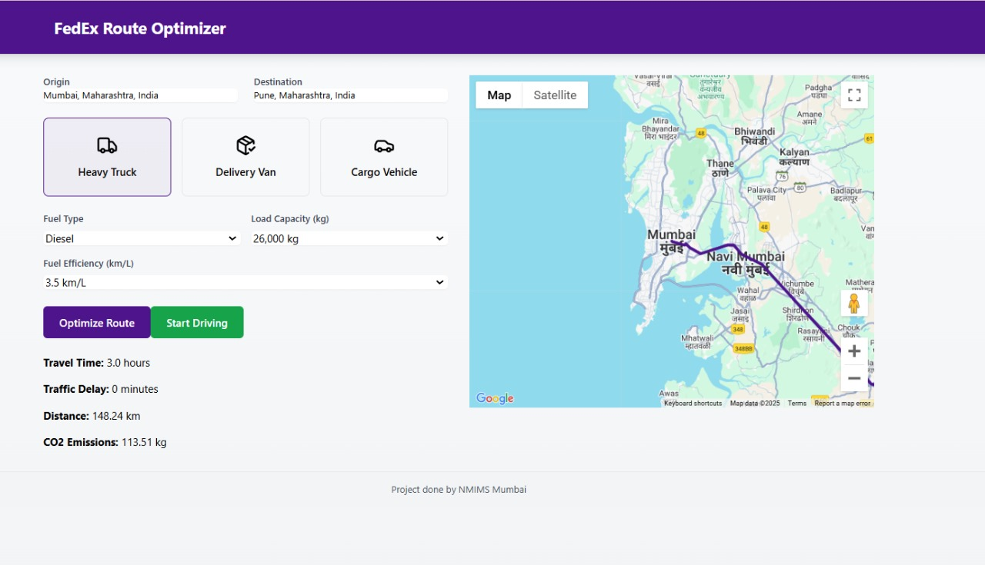
UI Overview

Slide 5
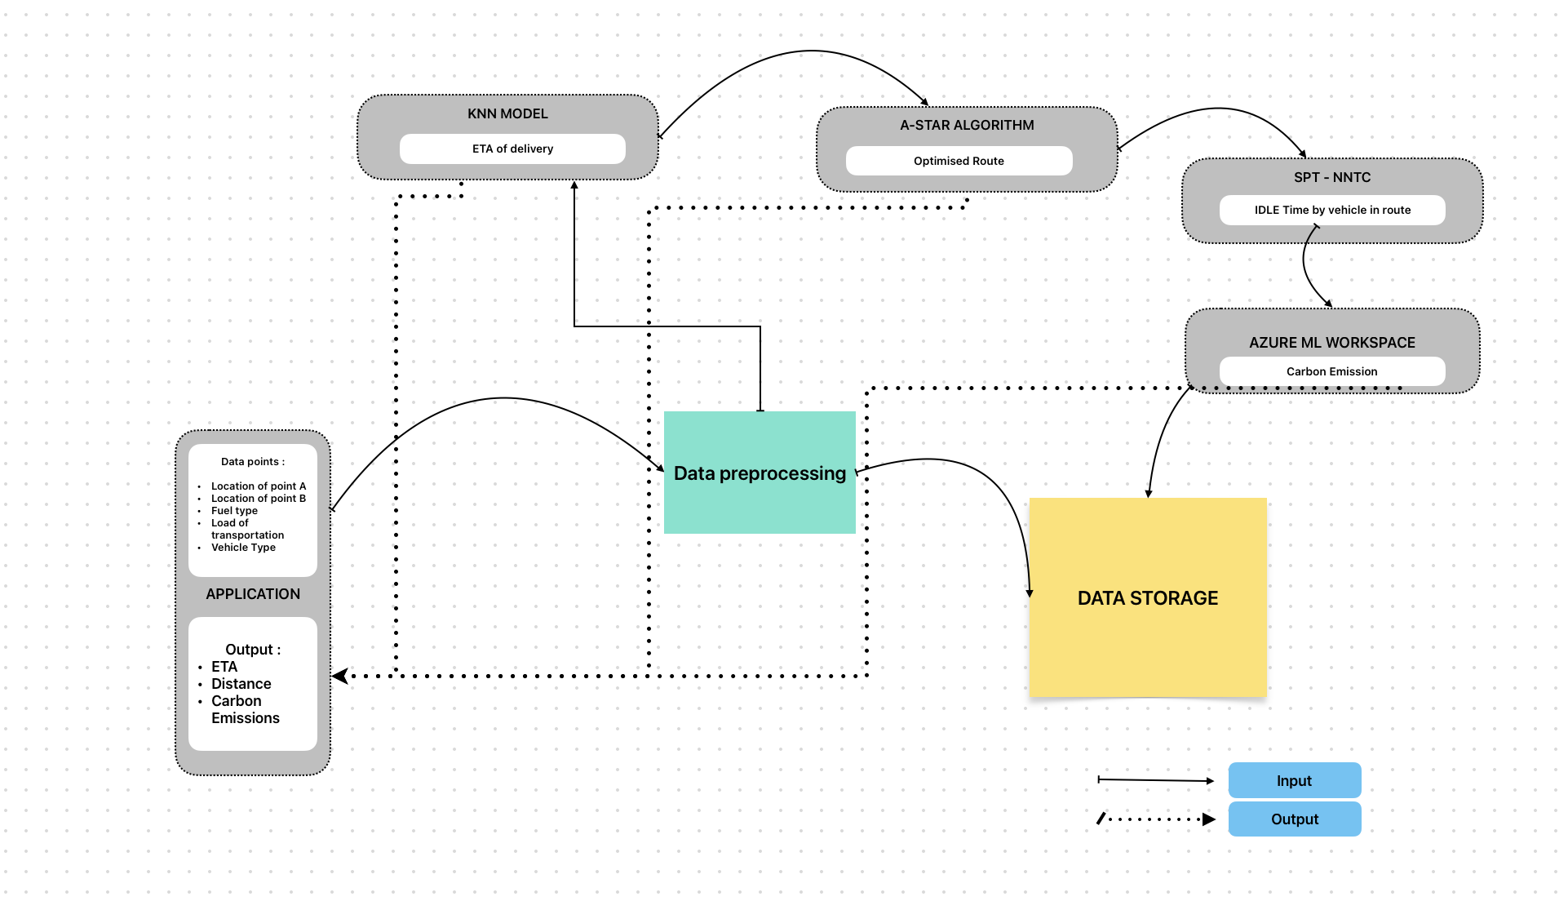
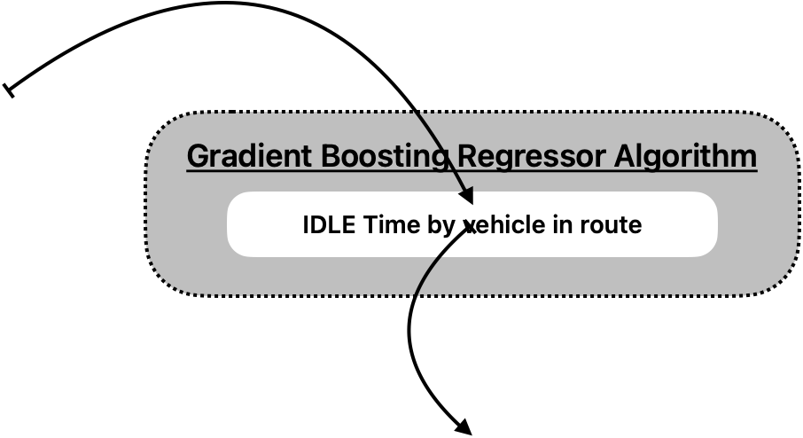
Workflow

Slide 6
Data Retrieval and Preprocessing :
Data Collection : We fetch data from various APIs :
Traffic flow data: TomTom API
Air Quality Index (AQI) data: AQcin API
Weather data: Weather API
Alternative routes: Google Maps Directions API
Route generation: OSRM
Preprocessing :
The collected JSON data is parsed into structured data frames.
Data cleaning and encoding are performed as required.
Traffic, AQI, and weather data are merged to create a comprehensive dataset for the next Step.

Slide 7
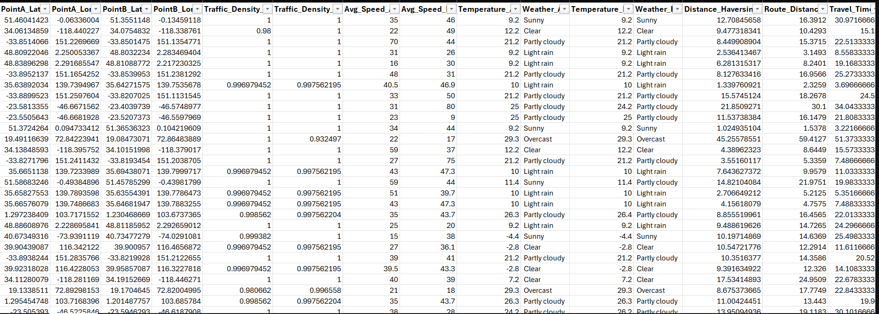
Data Retrieval and Preprocessing :
1000 pairs of coordinates Example : Mumbai to Pune

Slide 8
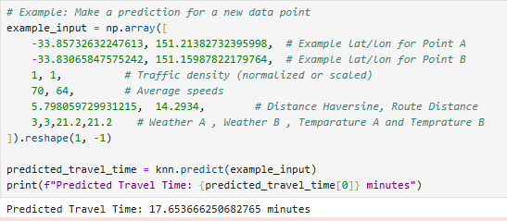
KNN model for Calculating ETA :
Assumptions: The vehicle condition is good , Driver behavior
Feature Engineering : for the calculation of like idle time of the engine , feature engineering is being used.
We employ a KNN for travel time estimation.
Model Training Dataset: The dataset includes features such as:
Latitude/longitude of points A and B
Traffic density and average speed at points A and B
Weather conditions at points A and B
Haversine distance and route distance
Time of day and day of the week
Model Workflow:
For each route, data about traffic and weather conditions at the start and end points is input into a pre-trained KNN model to estimate initial travel time.

Slide 9
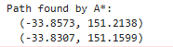
Selecting Shortest Route :-
A* Algorithm :
Pathfinding: Explore nodes using the cost function f(n)=g(n)+h(n)f(n) = g(n) + h(n)f(n)=g(n)+h(n), where g(n)g(n)g(n) is the actual cost, and h(n)h(n)h(n) is the heuristic.
Optimal Path: Continue until the goal is reached, reconstructing the shortest path

Slide 10
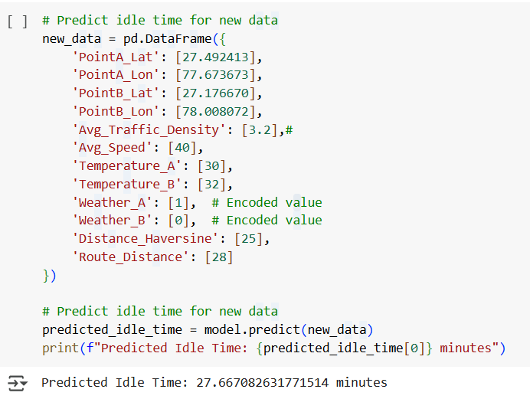
Reducing Idle Time For Engine :
Gradient Boosting Regressor Algorithm:
Here we are using gradient boosting regressor algorithm to estimate the idle time for engine based on multiple features like traffic density , route distance , average speed.
After then we calculated idle time by using the below formula :
Ideal time= Travel time -(route distance /average speed)
Model Training:
Initialize by take the mean of the Target variable that is idle time
Performing the residual difference
Fit the decision trees to predict residuals and then add trees prediction to get the refined model . Iterate the process.

Slide 11
Understanding the problems:
01
Problem with CO2 emissions from cars is that they contribute significantly to global warming and climate change. CO2 is a greenhouse gas that traps heat in the atmosphere, leading to a rise in global temperature.
02
Combustion of fossil fuels in cars produces CO2, as well as other greenhouse gases and air pollutants, such nitrogen oxide and particulate matter.
03
Emissions not only contribute to climate change, but they also have negative impacts on air quality and public health.
04
Rising global temperatures, melting ice caps, sea-level rise, changes in precipitation patterns, more frequent and severe weather events, and negative impacts on ecosystems and biodiversity
05
CO2 problem has negative impacts on human health, causing respiratory and cardiovascular diseases, among other health problems

Slide 12
Solution Outcome:
Predict CO2 emissions from cars with Azure Machine Learning
Predicting CO2 emissions from cars with Azure ML is to use a supervised learning algorithm, such as linear regression,and other regression model to build a model that can predict CO2 emissions based on input features such as engine size, fuel type, and vehicle weight.
Use Cases
Data preparation: Gather and preprocess a dataset of car features and corresponding CO2 emissions. This dataset could be obtained from public sources or collected internally. The dataset should be cleaned, formatted, and split into training and test sets.
Model training: Use Azure ML's automated machine learning capabilities or manually build and train a regression model using the training set. Evaluate the model's performance using metrics such as mean squared error or R-squared.
Model deployment: Deploy the trained model as a web service on Azure ML. This service can then be used to make predictions on new data inputs.
Monitoring and optimization: Monitor the performance of the deployed model and retrain it periodically to maintain accuracy. Additionally, consider optimizing the model by experimenting with different algorithms and hyperparameters.

Slide 13
AZURE MACHINE LEARNING COMPONENTS:
WORKSPACE
COMPUTES
DATASET
PIPELINE
SNAPSHOTS
TRAINING WORKFLOW
Workspace is the central resource in Azure that holds your machine learning pipelines, and all related resources.
Azure ML doesn't only manage models, it also provisions compute resources you can use to run them in training and inference mode.
Datasets make it easy to access and use your data.Azure ML creates references to your data, along with a copy of its metadata
Model is code that takes input and produces an output. A machine learning model typically involves algorithm, input dataset, and that affect how the algorithm generates outputs /predictions
Azure ML takes the directory containing the training scripts, compresses it, and copies it to the compute target. The script is then run on one or more compute targets
It can be helpful to understand how Azure Machine Learning operates and trains models behind the scenes

Slide 14
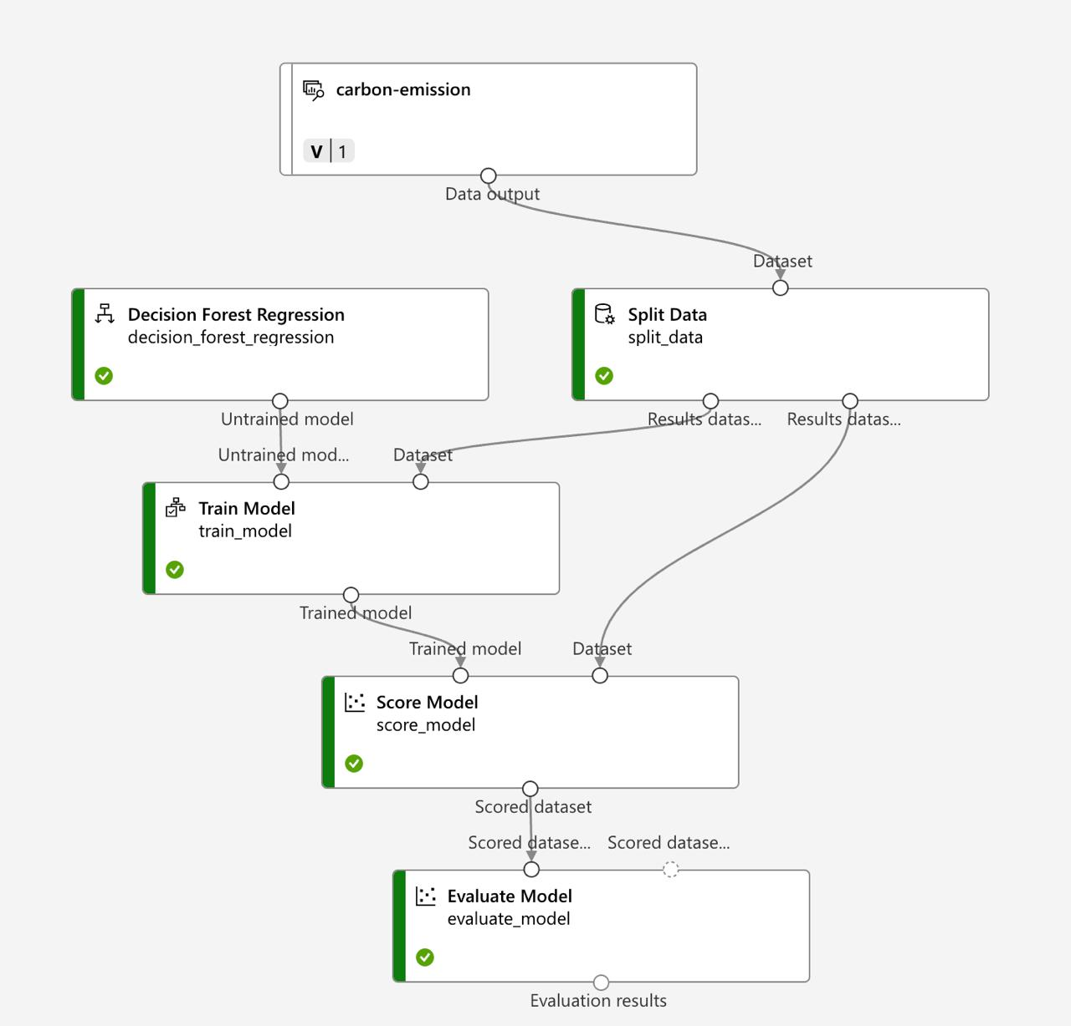
ML MODEL for CARBON EMISSION :

Slide 15
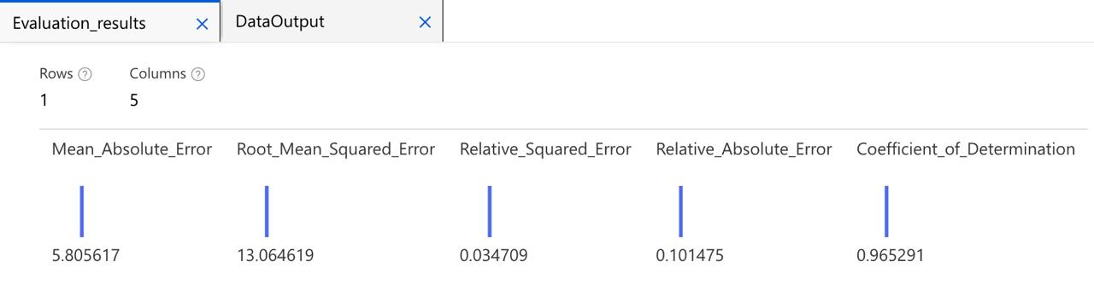
ML MODEL for CARBON EMISSION

Slide 16
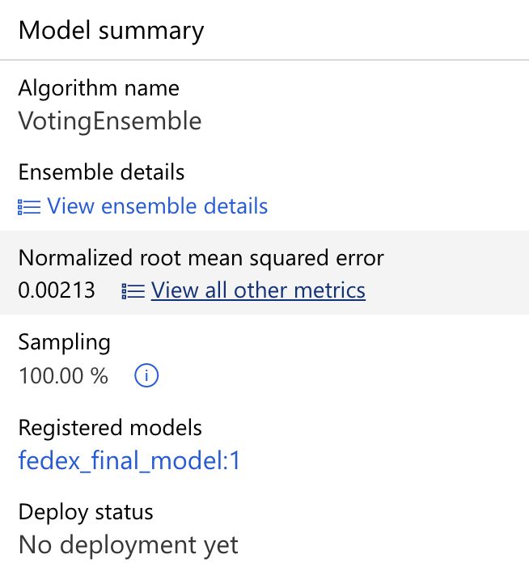
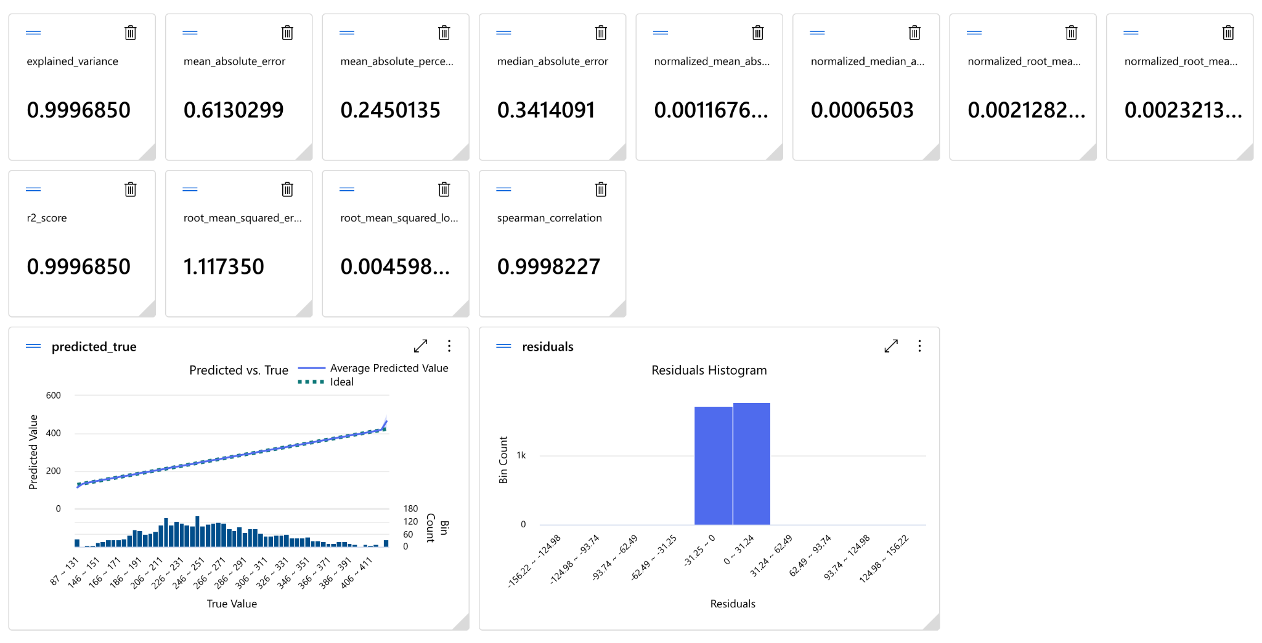
AUTOMATED ML MODEL for CARBON EMISSION :

Slide 17
Accuracy of model :
Accuracy of KNN model for ETA:
R^2 ( 0.827): The model explains 82.7% of the variance in ETA predictions. This indicates a high level of accuracy, though it’s slightly less than the first R² value, possibly due to different train-test splits or slight variations in data.
Mean Squared Error: (36.544)This value suggests that the average squared difference between the predicted ETA and the true ETA is 36.54 units (depending on your ETA units, e.g., minutes, hours). While this isn't a particularly low value, it reflects that the model's predictions are fairly close to the true values, though there's still some room for improvement.

Slide 18
Accuracy of model :
Accuracy of Idle time for Engine:
MAE ( 3.113)
On average, the absolute difference between the predicted idle time and the actual idle time is approximately 3.11 units (e.g., minutes or seconds, depending on the unit of measurement).This is a straightforward metric indicating that the model's predictions are reasonably accurate, with errors of around 3.11 on average.
MSE (17.96)
The Mean Squared Error represents the average squared difference between predicted and actual values. While it emphasizes larger errors more due to squaring, the value indicates that the squared errors are relatively small, reflecting the model's good predictive performance.However, because the MSE is less interpretable in its raw form (due to squaring), it’s better to use RMSE to get a sense of the average error.

Slide 19
Accuracy of model :
Accuracy of Idle time for Engine:
RMSE = 4.24:
RMSE is the square root of MSE, representing the average magnitude of errors in the same units as the target variable. This means that, on average, the model’s predictions for idle time deviate from the actual values by about 4.24 units.
Compared to MAE, RMSE tends to penalize larger errors more. In this case, the difference between RMSE (4.24) and MAE (3.11) indicates that there are some larger deviations (outliers) in the predictions, but they are not excessively large.

Slide 20
Accuracy of model :
Accuracy of Carbon emission model:
MAE = 0.61:On average, the absolute difference between the predicted carbon emissions and the actual emissions is 0.61 units (depending on the unit of measurement, e.g., grams, kilograms, etc.).This low MAE indicates that the model provides very precise predictions with minimal errors on average.
R² Score ( 0.99):An R² of 0.99 suggests that the model explains 99% of the variability in carbon emissions.This indicates that the model is almost perfect in terms of predicting the emissions based on the given features. It leaves only 1% of the variance unexplained, which is negligible.
RMSE (1.17) :Compared to the MAE (0.61), the slightly higher RMSE suggests that there are a few larger errors (outliers), but these are not significant enough to impact the model’s overall accuracy.

Slide 21
Challenges Faced :
Data Quality Issues: Incorrect addresses and missing variables in some rows required extensive cleaning and imputation, adding to preprocessing time.
Model Training: Imbalanced data and noisy features caused overfitting, requiring feature selection and hyperparameter tuning to improve generalization.
Deployment Limitations: Insufficient virtual machine computational resources delayed the model deployment and required optimization to run efficiently on the available infrastructure.

Slide 22
Challenges Faced :
Time Heuristic Sequential Approach :
Tried a heuristic sequential approach to minimize engine idle time because the nodes between the route were not pre-decided. In my approach, I was utilizing Nearest Neighbor Time Clustering (NNTC) to optimize the route and reduce engine idle time. However, since the nodes (or stops) were dynamic and not predetermined, the heuristic method became less effective. This created challenges in efficiently applying the NNTC algorithm, as the approach .
(implementation of scoring function in that)

Slide 23
Other Strategies :
Using Route optimization with AI:
Adding a layer of real-time visual recognition using cameras and AI to locate and identify packages faster, even in cluttered or complex environments.
Minimizing the errors with automated package detection and validation, reducing reliance on manual scanning and human mistakes.
Integrating with AR tools to guide workers directly to a package's location, speeding up retrieval in warehouses or delivery hubs.
Real-time object tracking, offering continuous monitoring of package locations within facilities without manual scans
linking inventory systems with real-world visual monitoring, ensuring better synchronization between digital and physical operations.
Enhancing in-house operational efficiency, speeding up sorting and retrieval without delays

Slide 24
Conclusion:
In conclusion, this project demonstrates the transformative power of real-time data integration, predictive modeling, and advanced optimization to improve transportation and logistics.
Key highlights include:
Optimal Routing with OSRM API: The OSRM API generates the most efficient routes using real-time road conditions, providing accurate and dynamic navigation for drivers.
Predictive Traffic Modeling: A hybrid KNN-ANN model enhances traffic predictions, ensuring routes stay optimized even during unforeseen disruptions.
Vehicle-Specific Optimization: Tailored strategies adapt to different vehicle types and delivery schedules, using heuristic sequencing and A* algorithms for precision.
Emission and Travel Analysis: Real-time evaluation of travel times and emissions fosters sustainable practices by reducing environmental impact.
This system strikes a balance between efficiency and sustainability, minimizing idle time, optimizing resources, and improving customer satisfaction, paving the way for a smarter and greener logistics ecosystem.

